Slide 1
Nashville City Cemetery Interments Top 10 Cause of Death
1846-1979 & 2017
Bashir Mahmood D09

Slide 2
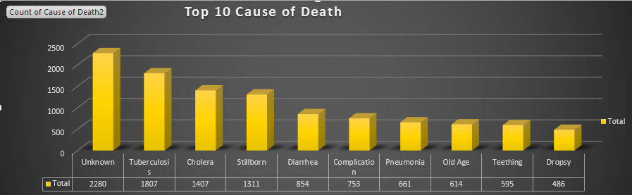

Slide 3

Number of Deaths by Month

Slide 4

Until the 19th century, creative medical technology had little effect on the health of society, but after that Vaccine Antibiotic Medication higher standards of living, improved nutrition, better hygiene, and Technology are the improvements over the centuries resulted from control of communicable diseases.
The control of communicable disease has been the major advance of the 20th century in scientific medicine. It reflects the combination of improved environmental conditions and public health together with the development of immunization, antimicrobial chemotherapy, and the increasing ability to identify new pathogenic organisms.

Slide 5
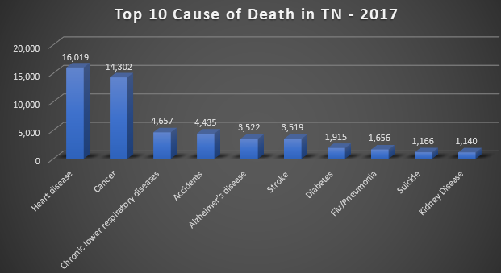

Slide 6
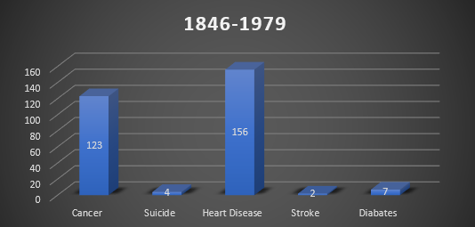
Up to the 1950s, conditions such as heart attacks, stroke, cancer, and diabetes were bundled together as degenerative disorders, implying that they might be the natural result of wear and tear and the inevitable consequence of aging.

Slide 7
FUN FACTS
Around 1832, Robert Anderson develops the first electric vehicle, but it isn't until the 1870s or later that electric cars become practical.
Ferdinand Porsche, founder of the sports car company by the same name, developed an electric car called the P1 in 1898. Around the same time, he created the world’s first hybrid electric car
Ernest Lamb, 23 years old Male dies on 11/16/1898.
Cause of death was Killed by elec cars
https://www.energy.gov/articles/history-electric-car

Slide 8
Questions?

